Slide 1
Chapter 8
Arrays
Objectives
❏ To understand the basic concepts and uses of arrays
❏ To be able to define C arrays
❏ To be able to pass arrays and array elements to functions
❏ To understand the classical approaches to sorting arrays: selection, bubble,
and insertion sorting
❏ To write programs that sort data using the three classical algorithms
❏ To be able to analyze the efficiency of a sort algorithm
❏ To understand the two classical search algorithms: sequential and binary
❏ To write programs that search arrays
❏ To be able to design test cases for sorting and searching algorithms
❏ To be able to analyze the efficiency of searching algorithms

Slide 2
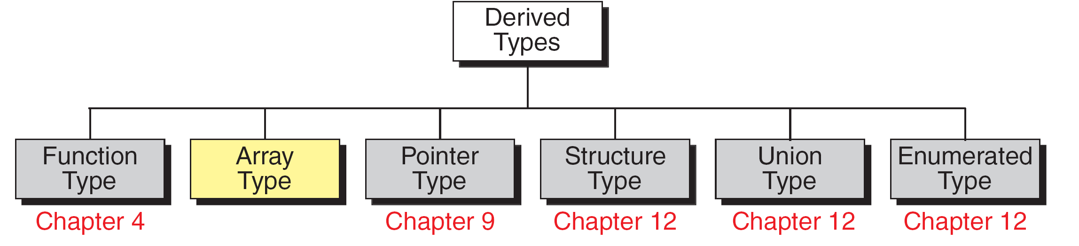
FIGURE 8-1 Derived Types

Slide 3
8-1 Concepts
Imagine we have a problem that requires us to read, process, and print a large number of integers. We must also keep the integers in memory for the duration of the program.
To process large amounts of data we need a powerful data structure, the array. An array is a collection of elements of the same data type.
Since an array is a sequenced collection, we can refer to the elements in the array as the first element, the second element, and so forth until we get to the last element.

Slide 4
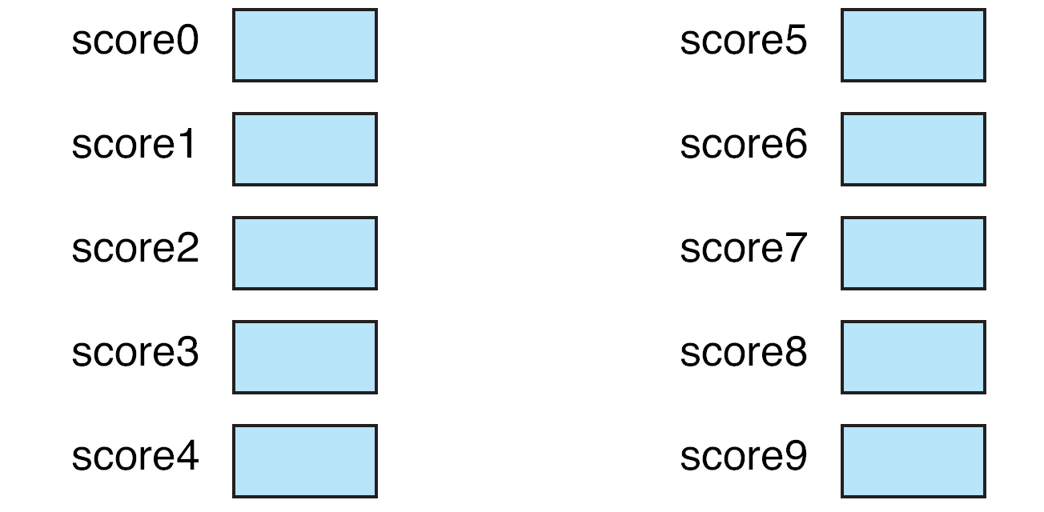
FIGURE 8-2 Ten Variables

Slide 5
FIGURE 8-3 Process 10 variables

Slide 6
FIGURE 8-4 An Array of Scores

Slide 7
FIGURE 8-5 Loop for 10 Scores

Slide 8
8-2 Using Arrays in C
In this section, we first show how to declare and define arrays. Then we present several typical applications using arrays including reading values into arrays, accessing and exchanging elements in arrays, and printing arrays.
Topics discussed in this section:
Declaration and Definition
Accessing Elements in Arrays
Storing Values in Arrays
Index Range Checking

Slide 9
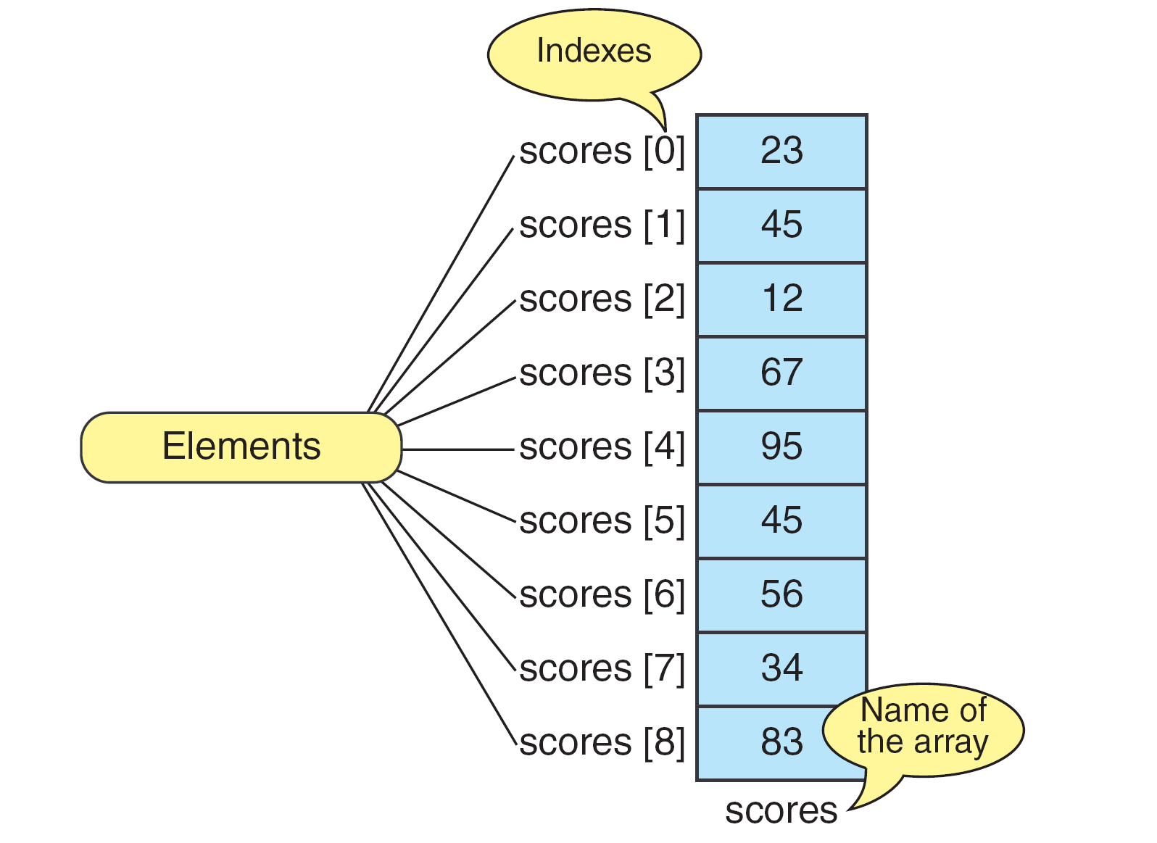
FIGURE 8-6 The Scores Array

Slide 10
FIGURE 8-7 Declaring and Defining Arrays

Slide 11
Note
Only fixed-length arrays can be initialized when they are defined. Variable length arrays must be initialized by inputting or assigning the values.

Slide 12
Accessing Elements in Arrays
scores[0]
scores[i]
element address = array address + (sizeof (element) * index)

Slide 13
FIGURE 8-8 Initializing Arrays

Slide 14
Inputting & Assigning Values
for (i = 0; i < 9; i++)
scanf (“%d”, &scores[i]);
scores[4] = 23;

Slide 15
Note
One array cannot be copied to another using assignment.

Slide 16
PROGRAM 8-1
Print Ten Numbers per Line

Slide 17
Precedence of Array References
numbers[3] = numbers[4] + 15;

Slide 18
PROGRAM 8-2
Squares Array

Slide 19
PROGRAM 8-2
Squares Array

Slide 20
PROGRAM 8-3
Print Input Reversed

Slide 21
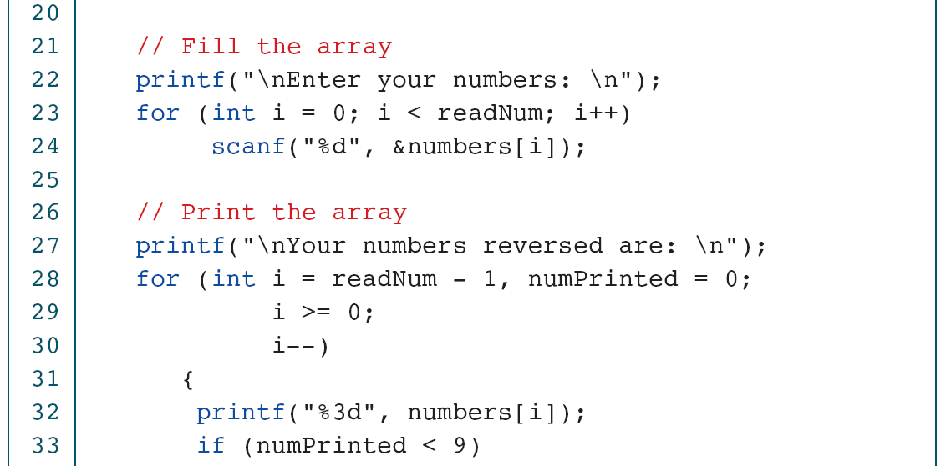
PROGRAM 8-2
Print Input Reversed

Slide 22
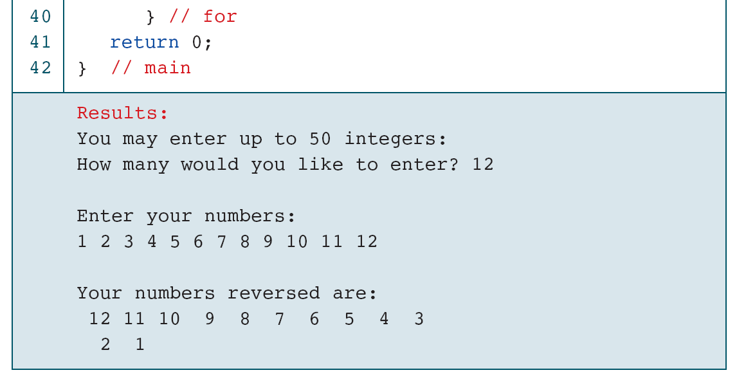
PROGRAM 8-2
Print Input Reversed

Slide 23
8-3 Inter-function Communication
To process arrays in a large program, we have to be able to pass them to functions. We can pass arrays in two ways: pass individual elements or pass the whole array. In this section we discuss first how to pass individual elements and then how to pass the whole array.
Topics discussed in this section:
Passing Individual Elements
Passing the Whole Array

Slide 24
FIGURE 8-11 Passing Array Elements

Slide 25
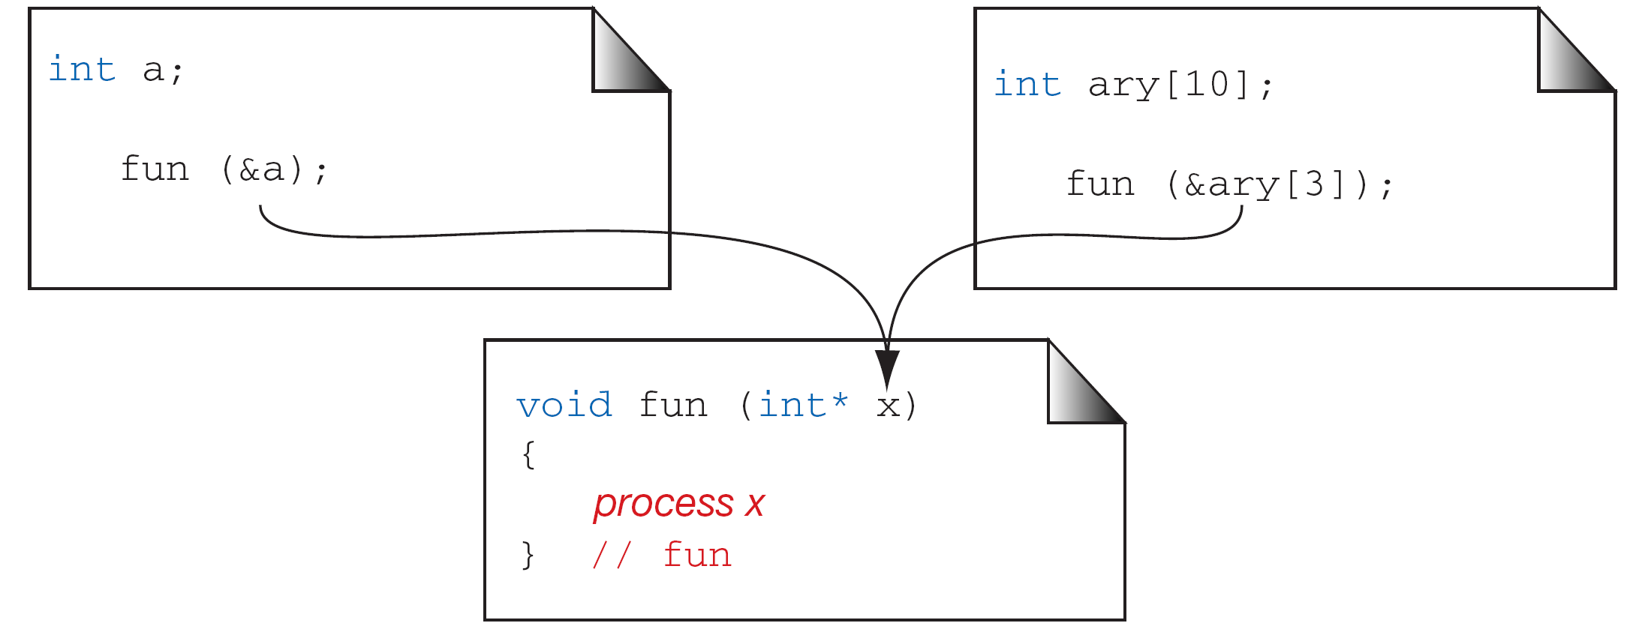
FIGURE 8-12 Passing the Address of an Array Element

Slide 26
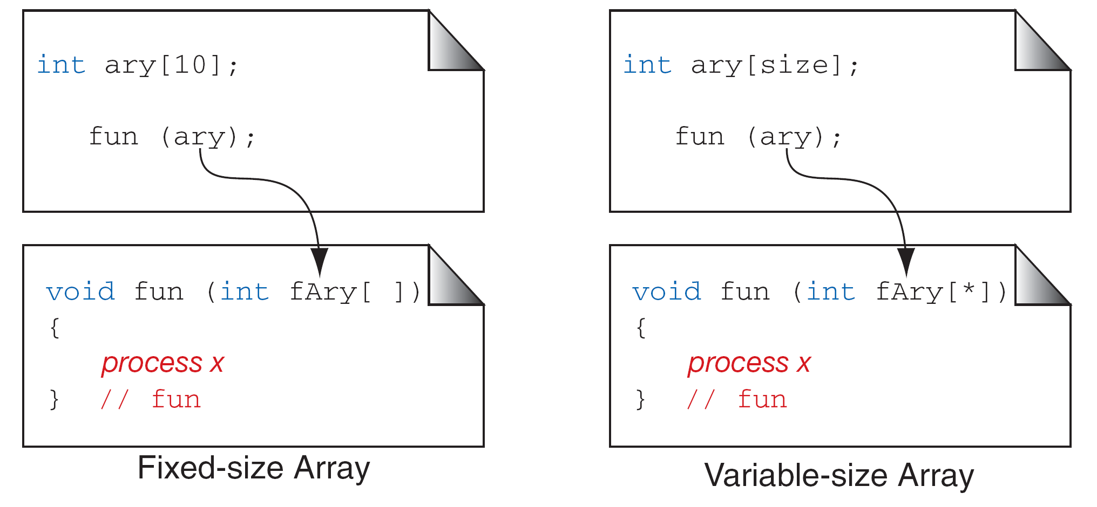
FIGURE 8-13 Passing the Whole Array

Slide 27
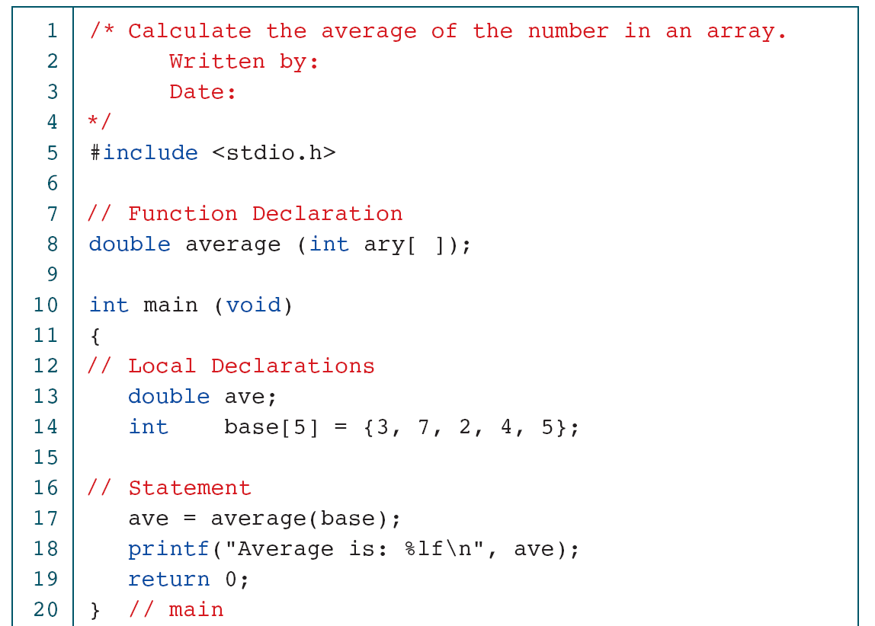
PROGRAM 8-4
Calculate Array Average

Slide 28
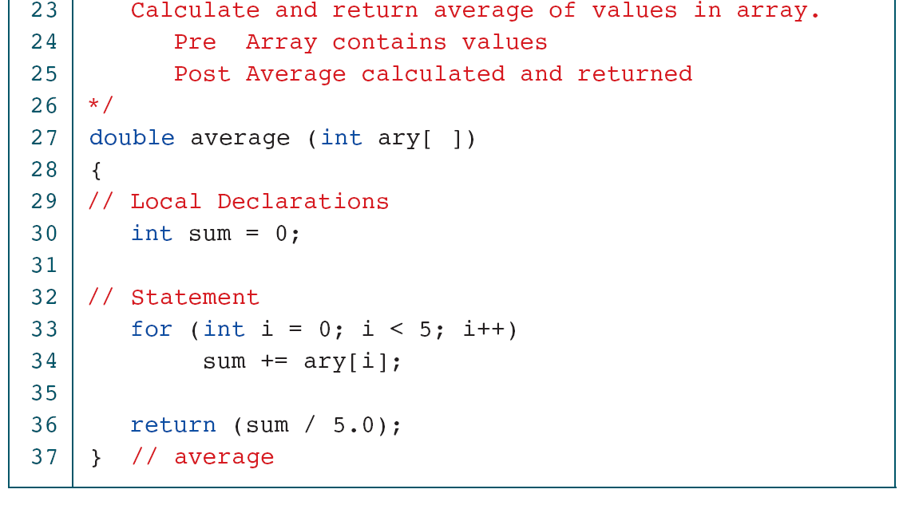
PROGRAM 8-4
Calculate Array Average

Slide 29
PROGRAM 8-6
Change Values in an Array

Slide 30
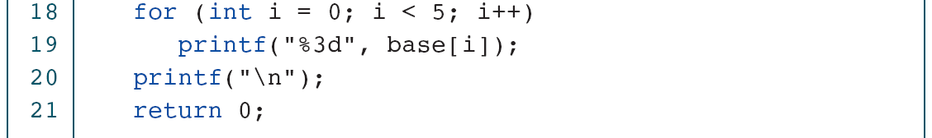
PROGRAM 8-6
Change Values in an Array

Slide 31
Passing an Array as a Constant
double average (const int ary[], int size);

Slide 32
8-4 Array Applications
In this section we study two array applications: frequency arrays with their graphical representations and random number permutations.
Topics discussed in this section:
Frequency Arrays
Histograms
Random Number Permutations

Slide 33
FIGURE 8-14 Frequency Array

Slide 34
FIGURE 8-15 Frequency Histogram

Slide 35
FIGURE 8-16 Histogram Program Design

Slide 36
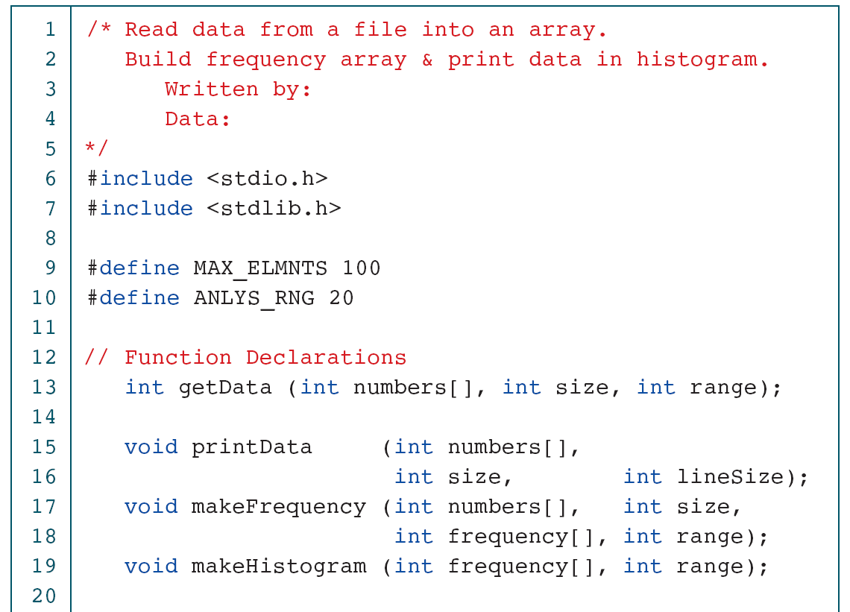
PROGRAM 8-7
Frequency and Histogram

Slide 37
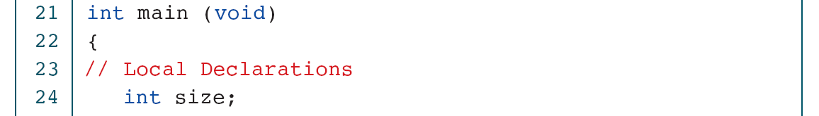
PROGRAM 8-7
Frequency and Histogram

Slide 38
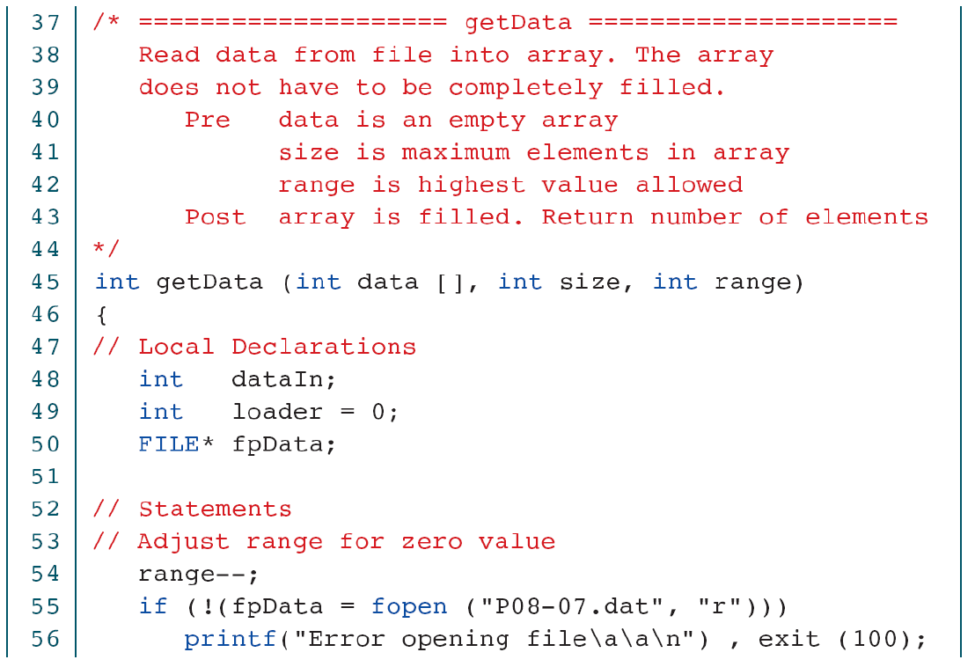
PROGRAM 8-7
Frequency and Histogram

Slide 39
PROGRAM 8-7
Frequency and Histogram

Slide 40
PROGRAM 8-7
Frequency and Histogram

Slide 41
PROGRAM 8-7
Frequency and Histogram

Slide 42
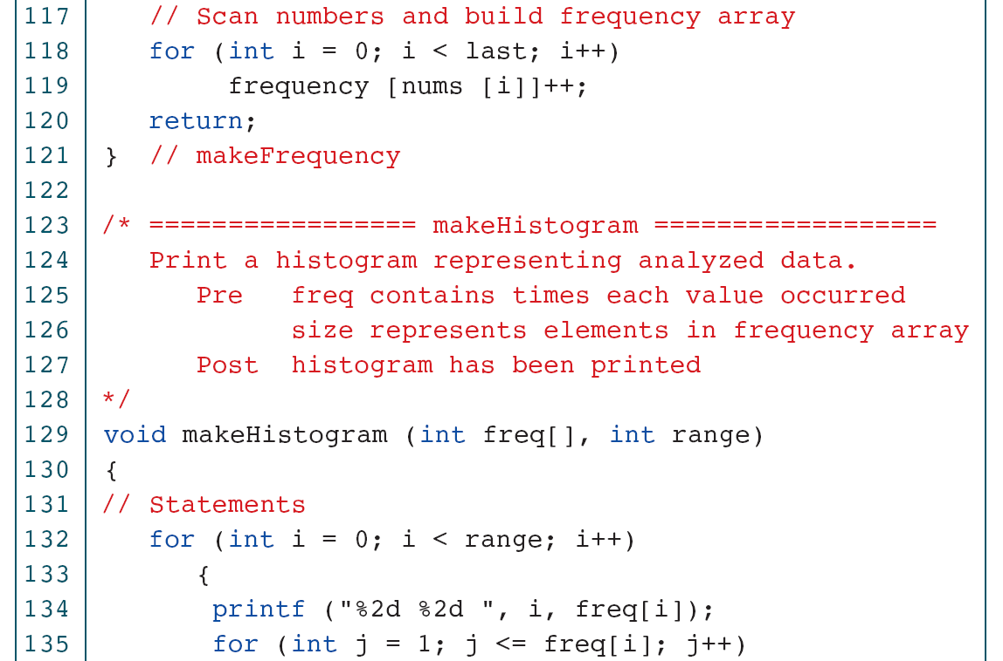
PROGRAM 8-7
Frequency and Histogram

Slide 43
PROGRAM 8-7
Frequency and Histogram

Slide 44
PROGRAM 8-7
Frequency and Histogram

Slide 45
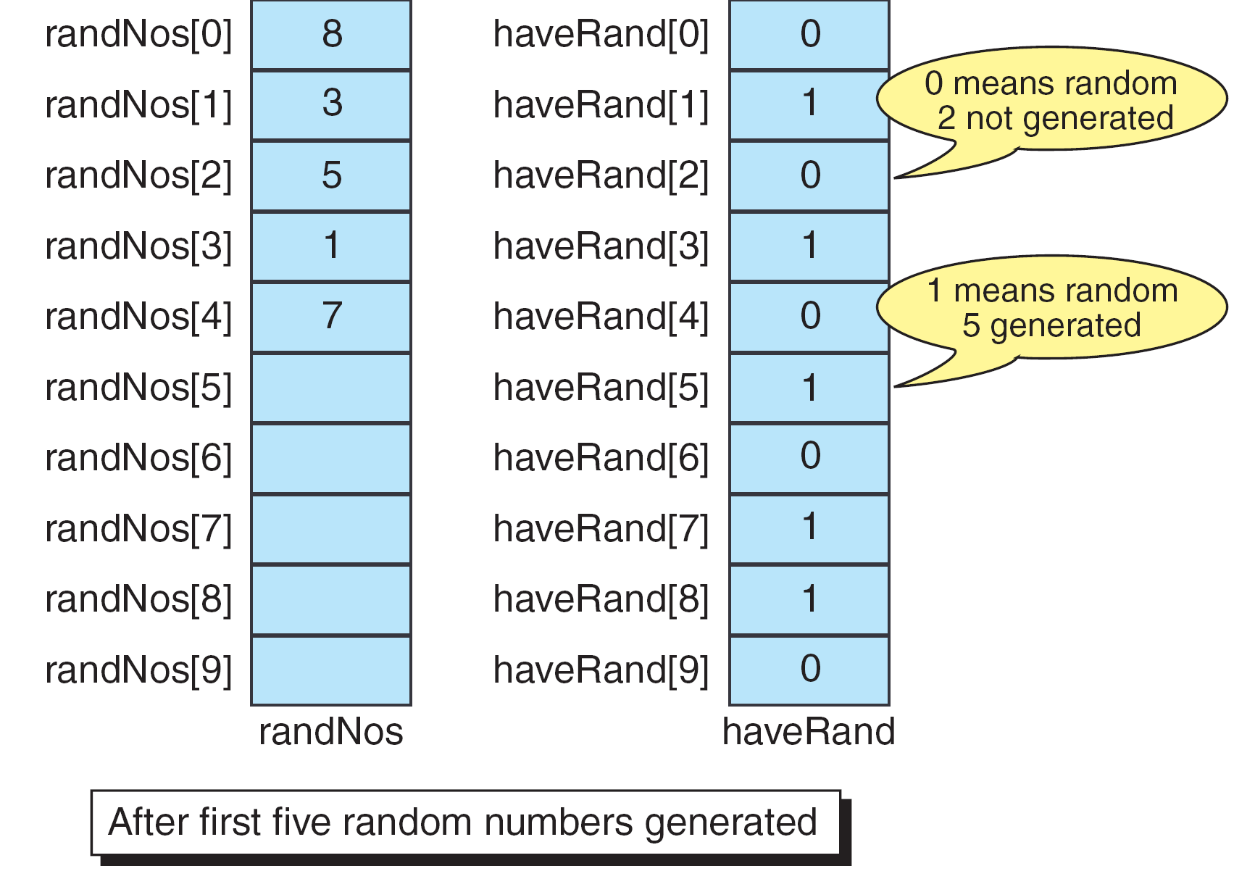
FIGURE 8-17 Design for Random Number Permutations

Slide 46
PROGRAM 8-8
Generate a Permutation

Slide 47
PROGRAM 8-8
Generate a Permutation

Slide 48
PROGRAM 8-8
Generate a Permutation

Slide 49
PROGRAM 8-8
Generate a Permutation

Slide 50
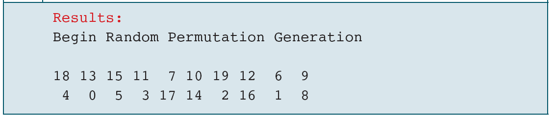
PROGRAM 8-8
Generate a Permutation

Slide 51
8-5 Sorting
One of the most common applications in computer science is sorting—the process through which data are arranged according to their values. We are surrounded by data. If the data are not ordered, we would spend hours trying to find a single piece of information.
Topics discussed in this section:
Selection Sort
Bubble Sort
Insertion Sort
Testing Sorts

Slide 52
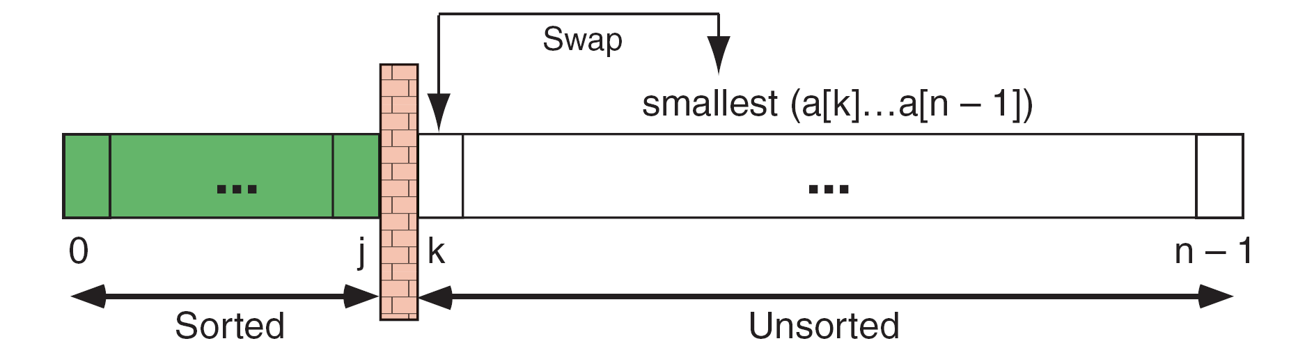
FIGURE 8-18 Selection Sort Concept

Slide 53
FIGURE 8-19 Selection Sort Example

Slide 54
FIGURE 8-20 Design for Selection Sort

Slide 55
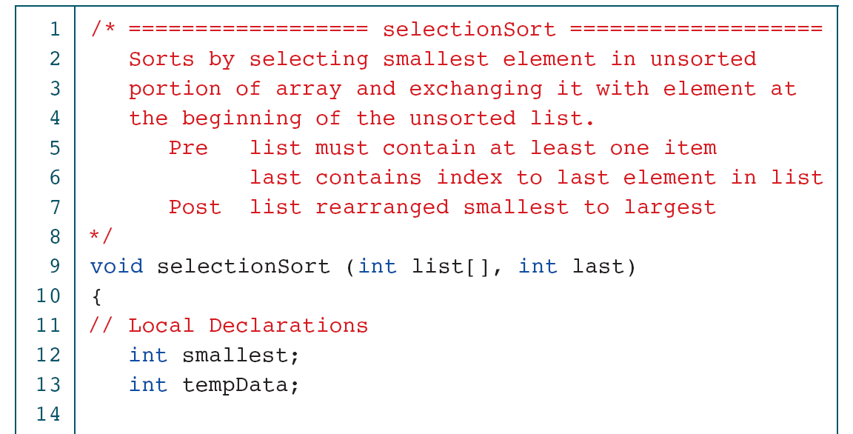
PROGRAM 8-9
Selection Sort

Slide 56
PROGRAM 8-9
Selection Sort

Slide 57
FIGURE 8-21 Bubble Sort Concept

Slide 58
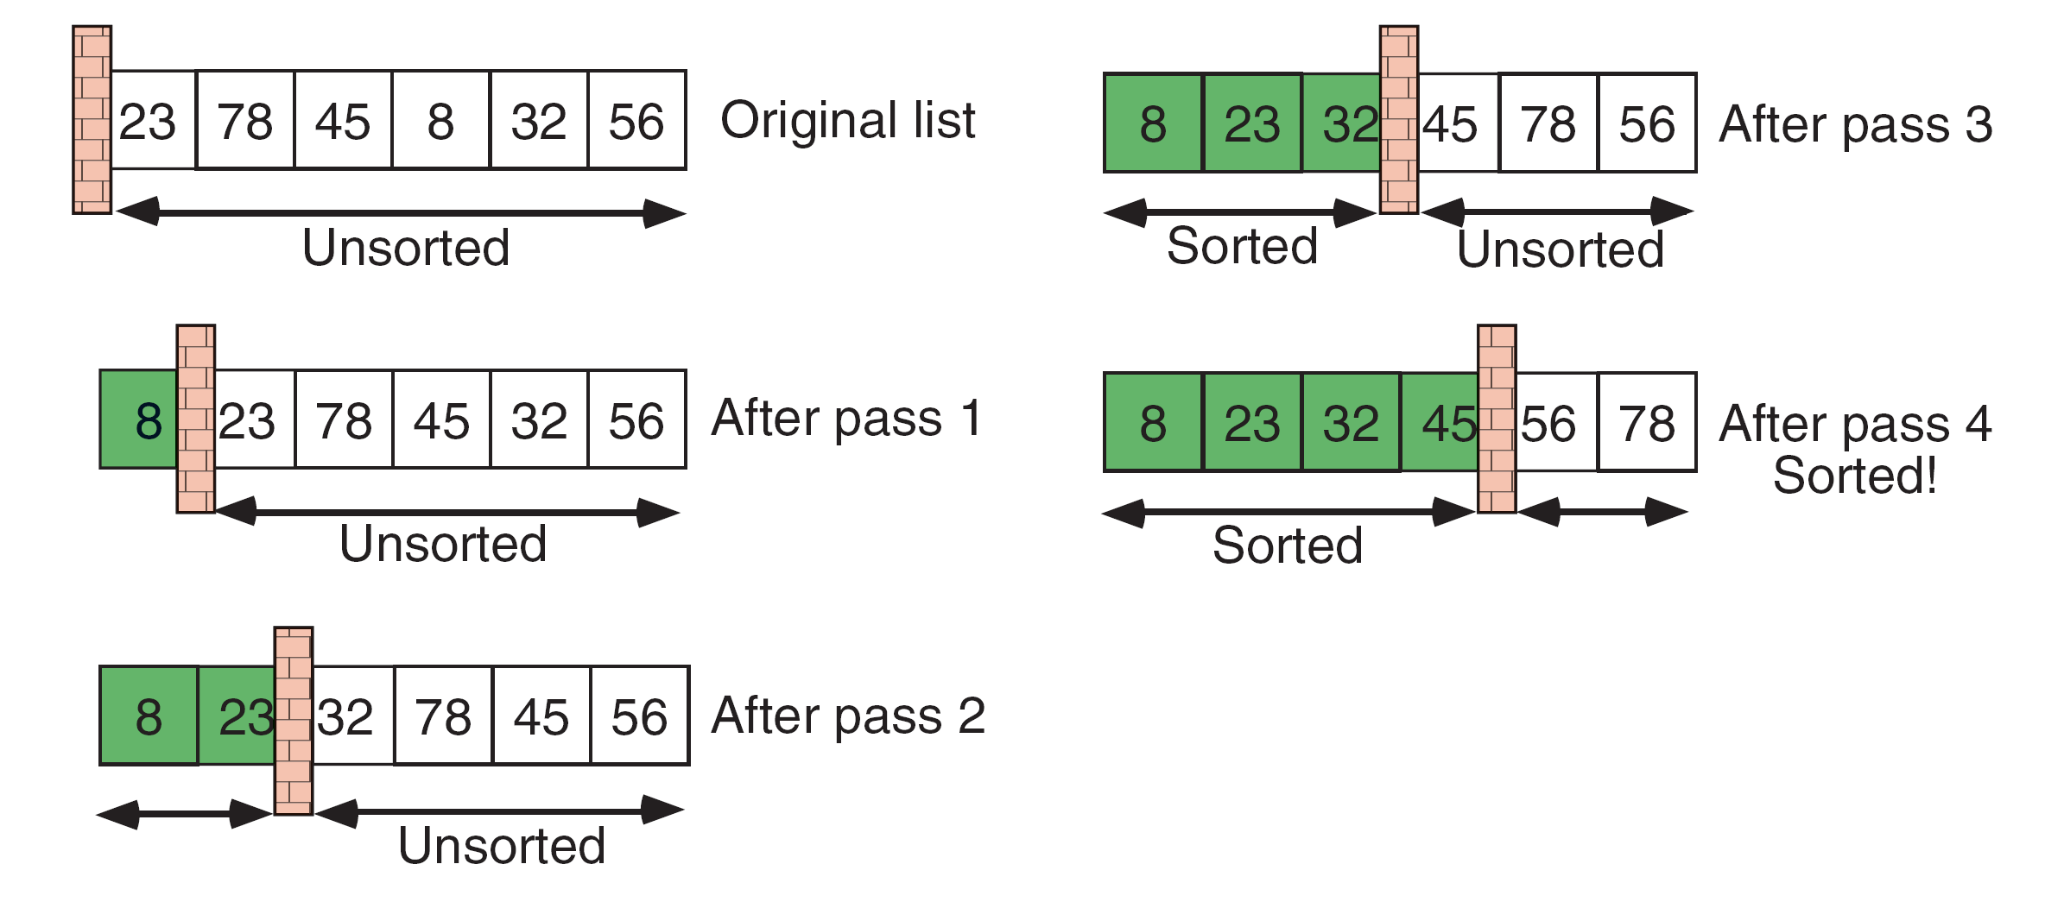
FIGURE 8-22 Bubble Sort Example

Slide 59
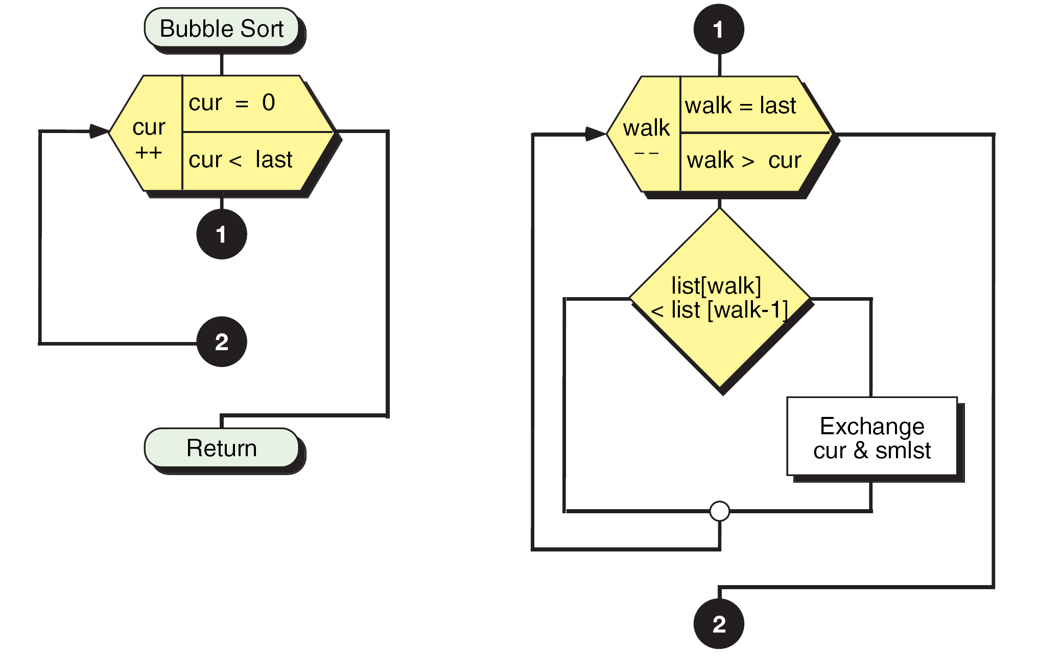
FIGURE 8-23 Bubble Sort Design

Slide 60
PROGRAM 8-10
Bubble Sort

Slide 61
PROGRAM 8-10
Bubble Sort

Slide 62
FIGURE 8-24 Insertion Sort Concept

Slide 63
FIGURE 8-25 Insertion Sort Example

Slide 64
FIGURE 8-26 Insertion Sort Design

Slide 65
PROGRAM 8-11
Insertion Sort

Slide 66
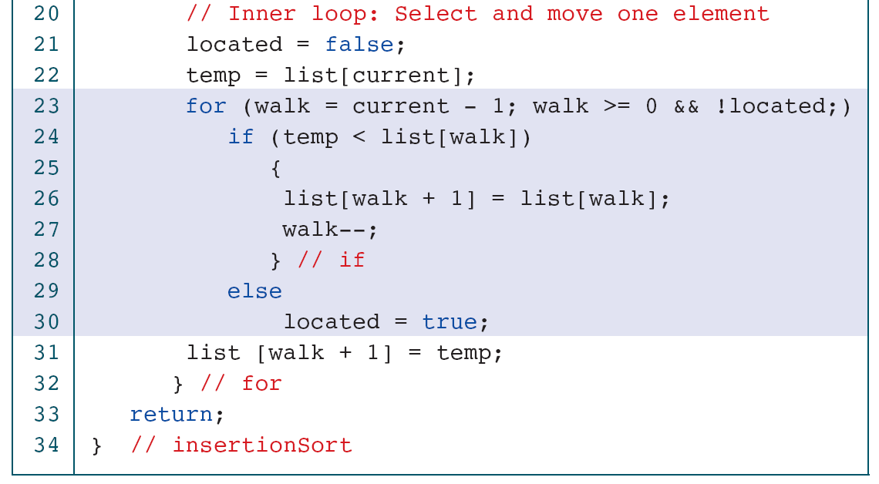
PROGRAM 8-11
Insertion Sort

Slide 67
PROGRAM 8-12
Testing Sorts

Slide 68
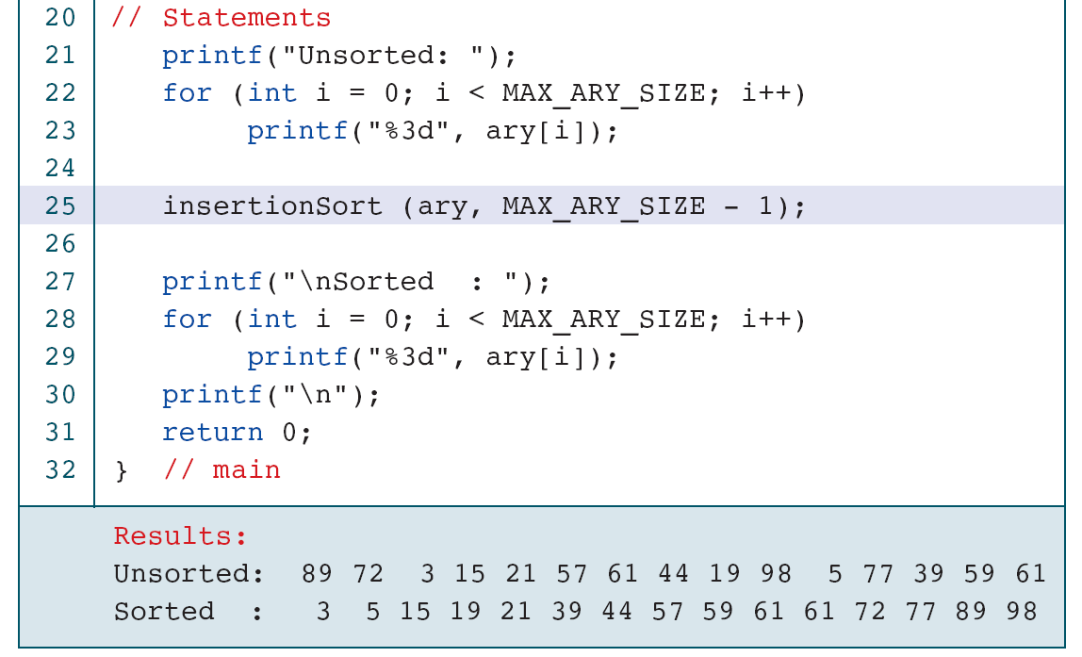
PROGRAM 8-12
Testing Sort

Slide 69
Table 8-1
Sort Exchanges and Passes

Slide 70
8-6 Searching
Another common operation in computer science is searching, which is the process used to find the location of a target among a list of objects. In the case of an array, searching means that given a value, we want to find the location (index) of the first element in the array that contains that value.
Topics discussed in this section:
Sequential Search
Binary Search

Slide 71
FIGURE 8-27 Search Concept

Slide 72
FIGURE 8-28 Locating Data in Unordered List

Slide 73
FIGURE 8-29 Unsuccessful Search in Unordered List

Slide 74
FIGURE 8-30 Sequential Search Design

Slide 75
PROGRAM 8-13
Sequential Search

Slide 76
PROGRAM 8-13
Sequential Search

Slide 77
FIGURE 8-31 Binary Search Example

Slide 78
FIGURE 8-32 Unsuccessful Binary Search Example

Slide 79
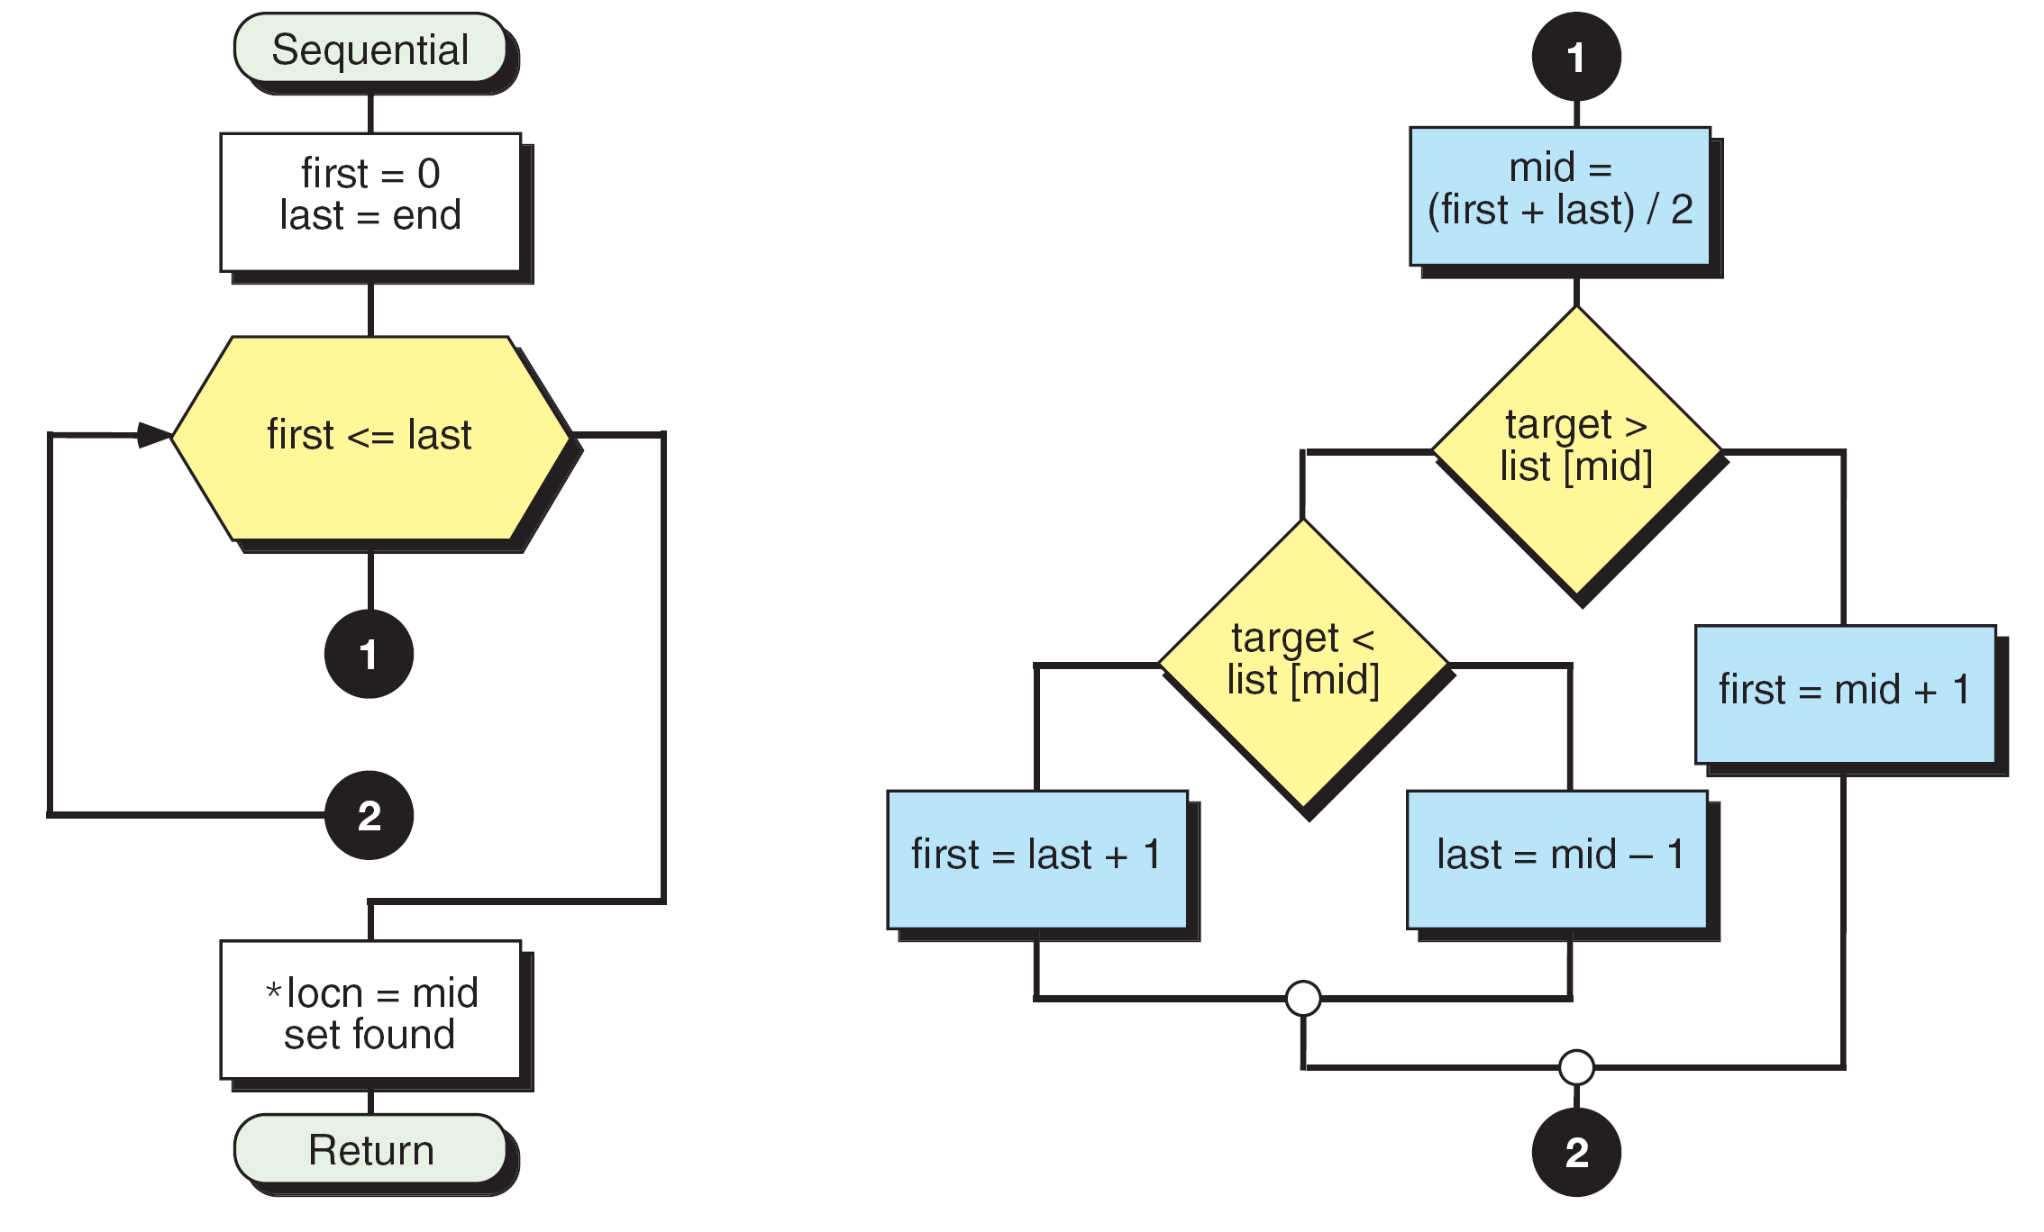
FIGURE 8-33 Design for Binary Search

Slide 80
PROGRAM 8-14
Binary Search

Slide 81
PROGRAM 8-14
Binary Search

Slide 82
8-7 Two-Dimensional Arrays
The arrays we have discussed so far are known as one-dimensional arrays because the data are organized linearly in only one direction. Many applications require that data be stored in more than one dimension. One common example is a table, which is an array that consists of rows and columns.
Topics discussed in this section:
Declaration
Passing A Two-Dimensional Array

Slide 83
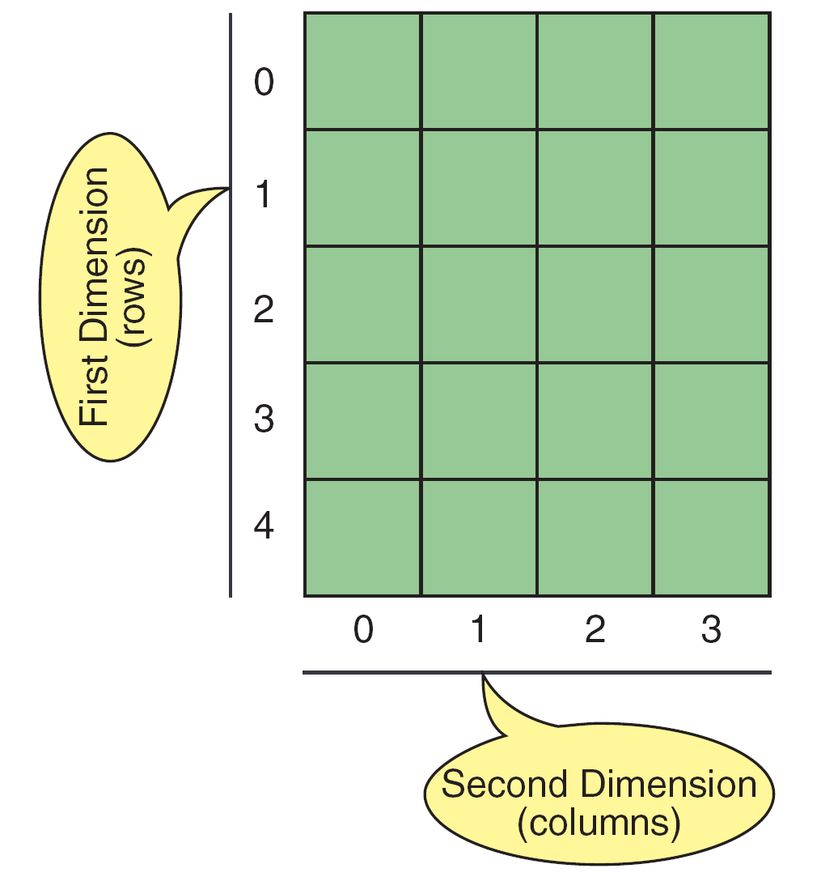
FIGURE 8-34 Two-dimensional Array

Slide 84
FIGURE 8-35 Array Of Arrays

Slide 85
Declaration
int table[5][4];
int table[3][2] = {0, 1, 2, 3, 4, 5};
int table[3][2] = { {0, 1}, {2, 3}, {4, 5} };
int table[][2] = {{0, 1}, {2, 3}, {4, 5} };
int table[3][2] = {0};
table[r][w]
&table[r][w]

Slide 86
PROGRAM 8-15
Fill Two-dimensional Array

Slide 87
FIGURE 8-36 Memory Layout

Slide 88
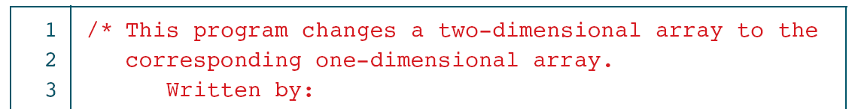
PROGRAM 8-16
Convert Table to One-dimensional Array

Slide 89
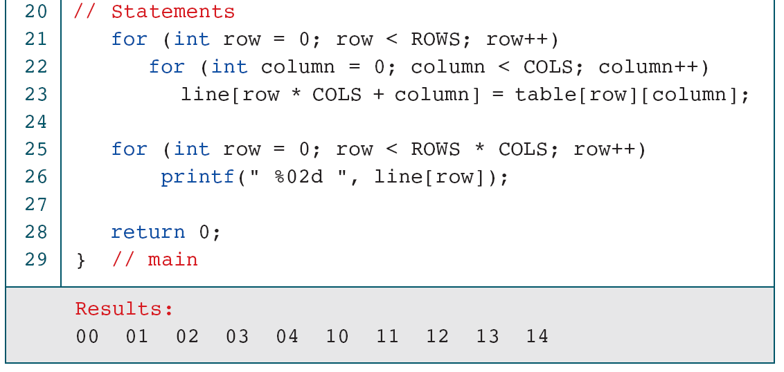
PROGRAM 8-16
Convert Table to One-dimensional Array

Slide 90
Passing a 2D Array
Passing a row
void print_square (int []);
int table[MAX_ROWS][MAX_COLS];
print_square(table[row]);
Passing the whole array
double average (int table[][MAX_COLS]);
int table[MAX_ROWS][MAX_COLS];
avg = average(table);

Slide 91
FIGURE 8-37 Passing a Row

Slide 92
FIGURE 8-39 Example of Filled Matrix

Slide 93
PROGRAM 8-17
Fill Matrix

Slide 94
PROGRAM 8-17
Fill Matrix

Slide 95
8-8 Multidimensional Arrays
Multidimensional arrays can have three, four, or more dimensions. The first dimension is called a plane, which consists of rows and columns. The C language considers the three-dimensional array to be an array of two-dimensional arrays.
Topics discussed in this section:
Declaring Multidimensional Arrays

Slide 96
Declaring Multi-D Arrays
int table[3][5][4];
int table[planes][rows][cols];
Initialization?

Slide 97
FIGURE 8-40 A Three-dimensional Array (3 x 5 x 4)

Slide 98
FIGURE 8-41 C View of Three-dimensional Array

Slide 99
8-9 Programming Example— Calculate Averages
We previously introduced the programming concept known as incremental development. In this chapter we develop an example—calculate average—that contains many of the programming techniques.
Topics discussed in this section:
First Increment: mainYour First C
Second Increment: Get Data
Third Increment: Calculate Row Averages
Fourth Increment: Calculate Column Averages
Fifth Increment: Print Tables

Slide 100
FIGURE 8-42 Data Structures For Calculate Row–Column Averages

Slide 101
FIGURE 8-43 Calculate Row–Column Average Design

Slide 102
PROGRAM 8-18
Calculate Row and Column Averages: main

Slide 103
PROGRAM 8-19
Calculate Row and Column Averages: Get Data

Slide 104
PROGRAM 8-19
Calculate Row and Column Averages: Get Data

Slide 105
PROGRAM 8-19
Calculate Row and Column Averages: Get Data

Slide 106
PROGRAM 8-19
Calculate Row and Column Averages: Get Data

Slide 107
PROGRAM 8-20
Calculate Row and Column Averages: Row Averages

Slide 108
PROGRAM 8-20
Calculate Row and Column Averages: Row Averages

Slide 109
PROGRAM 8-20
Calculate Row and Column Averages: Row Averages

Slide 110
PROGRAM 8-20
Calculate Row and Column Averages: Row Averages

Slide 111
PROGRAM 8-20
Calculate Row and Column Averages: Row Averages

Slide 112
8-10 Software Engineering
In this section, we discuss two basic concepts: testing and algorithm efficiency. To be effective, testing must be clearly thought out. We provide some concepts for testing array algorithms by studying sorting and searching. We then continue the algorithm efficiency discussion started in Chapter 6.
Topics discussed in this section:
Testing Sorts
Testing Searches
Analyzing Sort Algorithms
Analyzing Search Algorithms

Slide 113
Table 8-2
Recommended Sort Test Cases

Slide 114
Note
When testing an array search, always access the first and last elements.

Slide 115
Table 8-3
Test cases for searches

Slide 116
Note
The efficiency of the bubble sort is O(n²).

Slide 117
PROGRAM 8-10
Bubble Sort

Slide 118
PROGRAM 8-10
Bubble Sort

Slide 119
Note
The efficiency of the selection sort is O(n²).

Slide 120
PROGRAM 8-9
Selection Sort

Slide 121
PROGRAM 8-9
Selection Sort

Slide 122
Note
The efficiency of the insertion sort is O(n²).

Slide 123
PROGRAM 8-11
Insertion Sort

Slide 124
PROGRAM 8-11
Insertion Sort

Slide 125
Note
The efficiency of the sequential search is O(n).

Slide 126
PROGRAM 8-13
Sequential Search

Slide 127
PROGRAM 8-13
Sequential Search

Slide 128
Note
The efficiency of the binary search is O(logn).

Slide 129
PROGRAM 8-14
Binary Search

Slide 130
PROGRAM 8-14
Binary Search

Slide 131
Table 8-4
Comparison of binary and sequential searches

